Slide 1
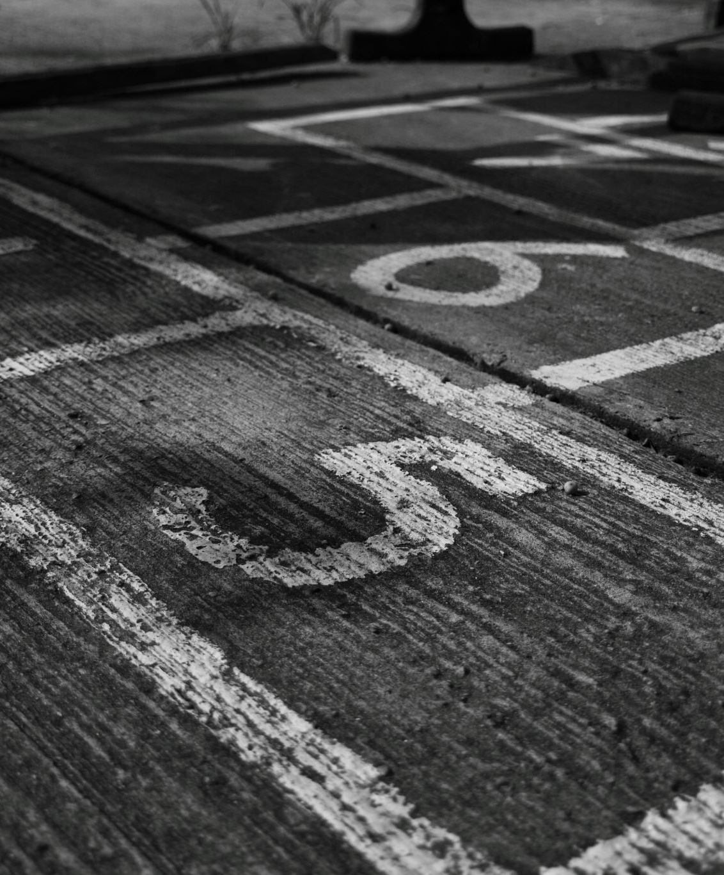
San Francisco Crime Analysis
The goal is to uncover crime patterns by time, type, and location to support data-informed public safety decisions.
Tools Used: PySpark, SQL, Tableau, Pandas, matplotlib

Slide 2

Overview
This project analyzes San Francisco’s public crime data using PySpark and SQL for large-scale processing and Tableau for interactive visualization. The goal is to uncover patterns in crime distribution by time, type, and location to help inform public safety initiatives.
Tools used: PySpark, Pandas, Tableau, SQL, matplotlib

Slide 3
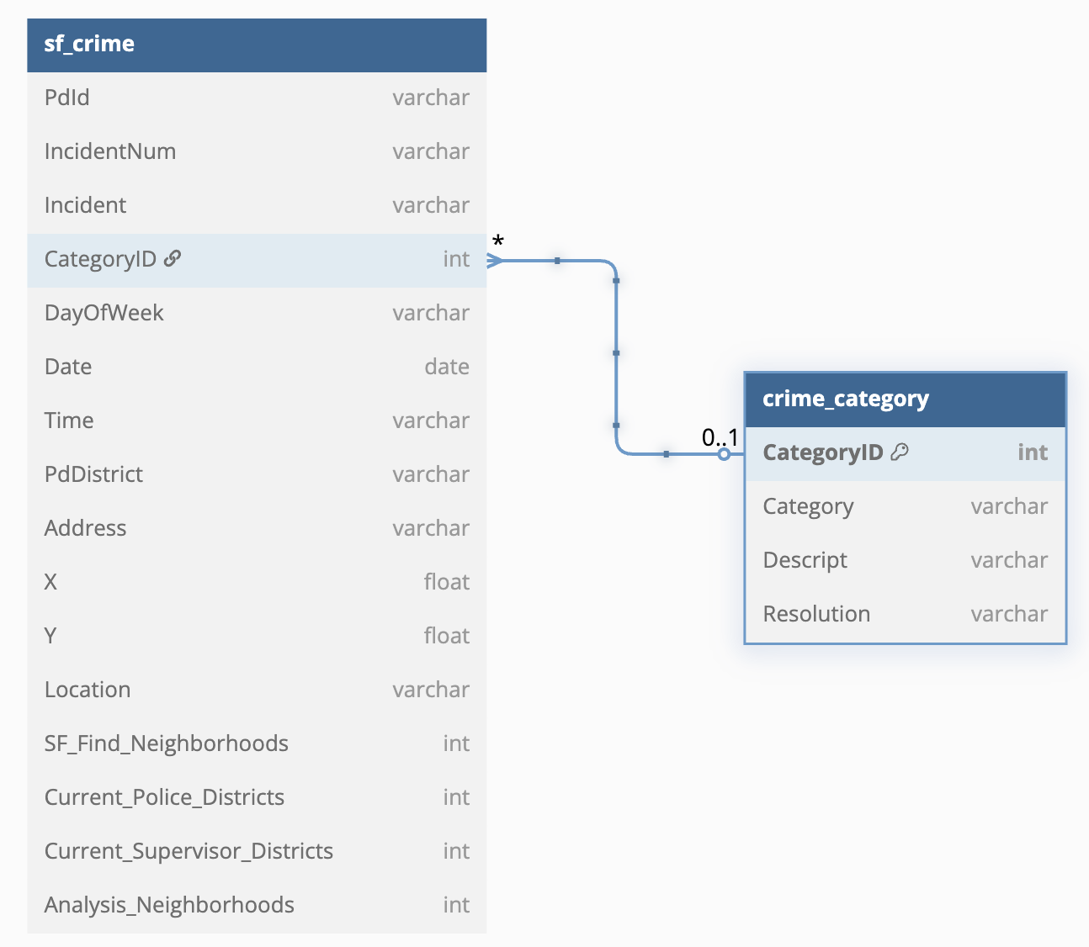
Data Schema
I used PySpark’s SparkSession to load the original dataset, which includes over 5,900 rows and 33 columns. The data was loaded from a CSV file hosted on Databricks' DBFS.
This project uses a cleaned dataset of San Francisco crime records. The data was structured into a relational schema with two main tables: a fact table sf_crime and a dimension table crime_category.

Slide 4
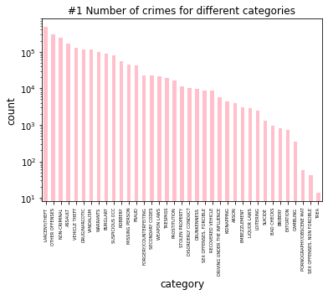
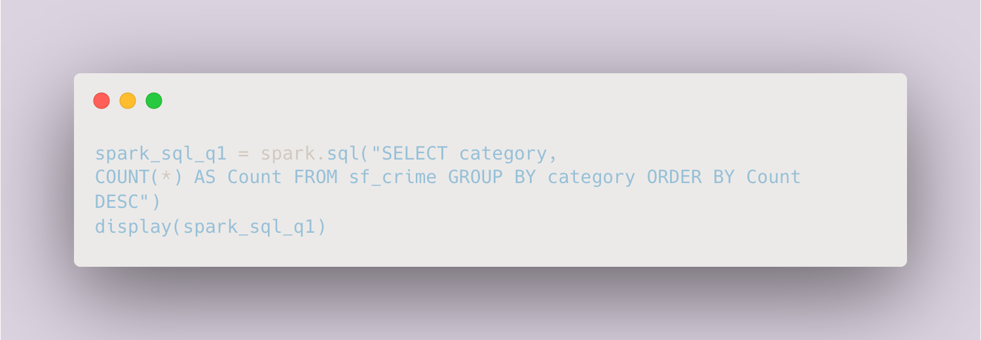
Crime Categories – Frequency Analysis
This step helps identify which crime types are the most frequent in San Francisco. The results reveal that certain categories such as LARCENY/THEFT, VEHICLE THEFT, and ASSAULT occur more frequently than others, indicating potential areas for increased law enforcement or preventive measures.

Slide 5
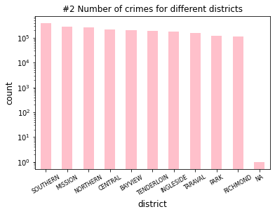
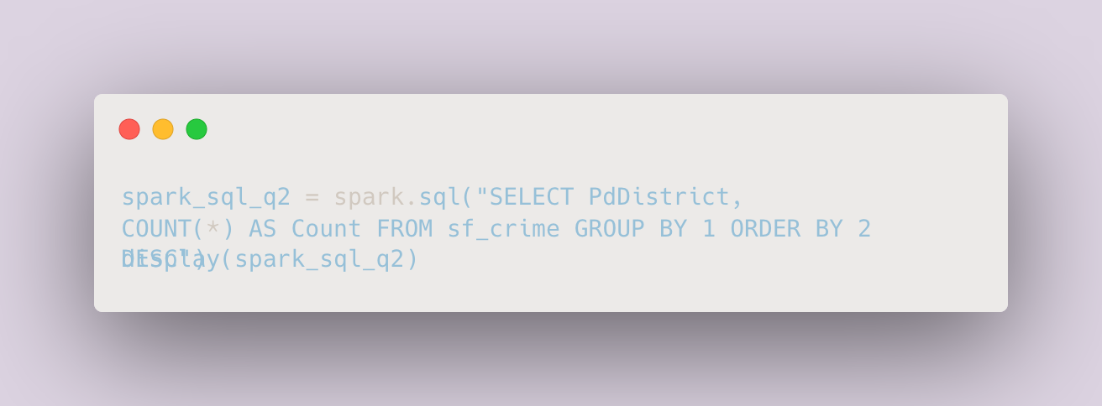
Crime Distribution by District
The chart shows that Southern, Mission, and Northern districts experience the highest crime volumes. This insight helps target resources to the areas with the greatest need for policing and crime prevention.

Slide 6
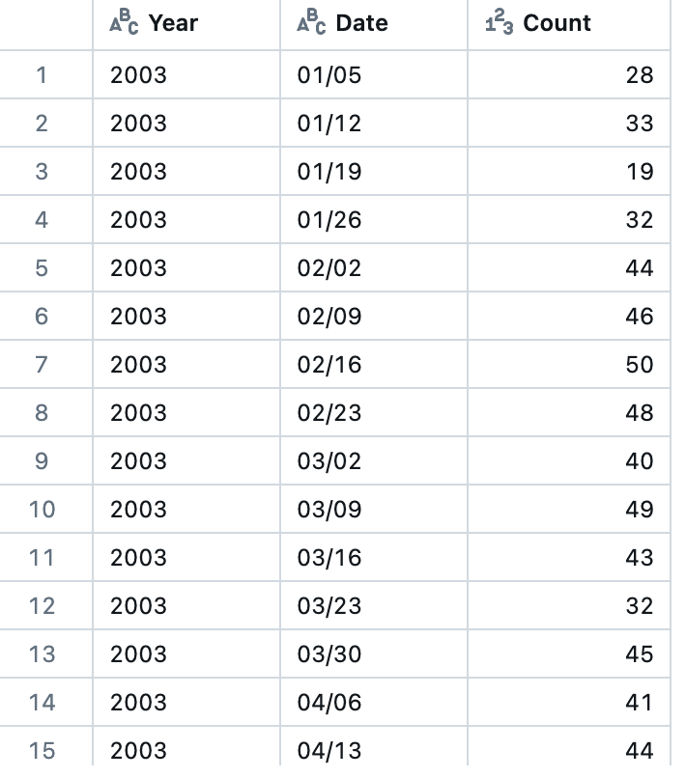
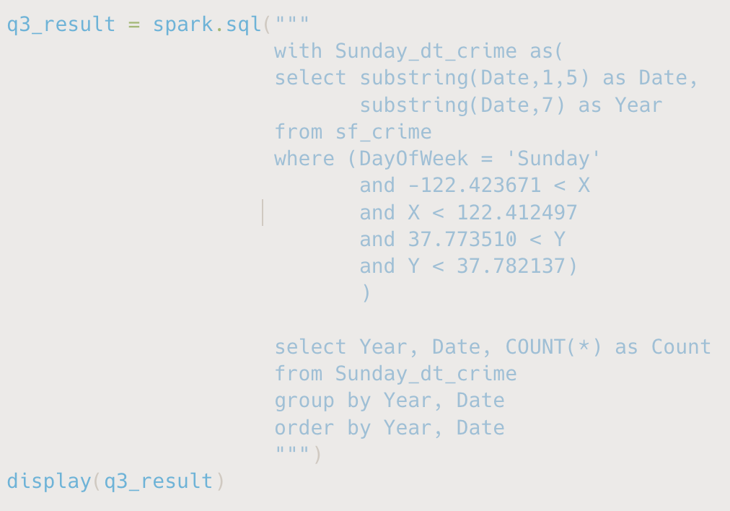
Spatiotemporal Analysis: Sunday Crimes in Downtown SF
This query performs a spatiotemporal analysis, focusing on crimes that occurred on Sundays within the defined downtown San Francisco area.
I focused on Sunday incidents in downtown San Francisco, defined by bounding box coordinates, to investigate potential weekend-related crime spikes in high-foot-traffic areas.

Slide 7
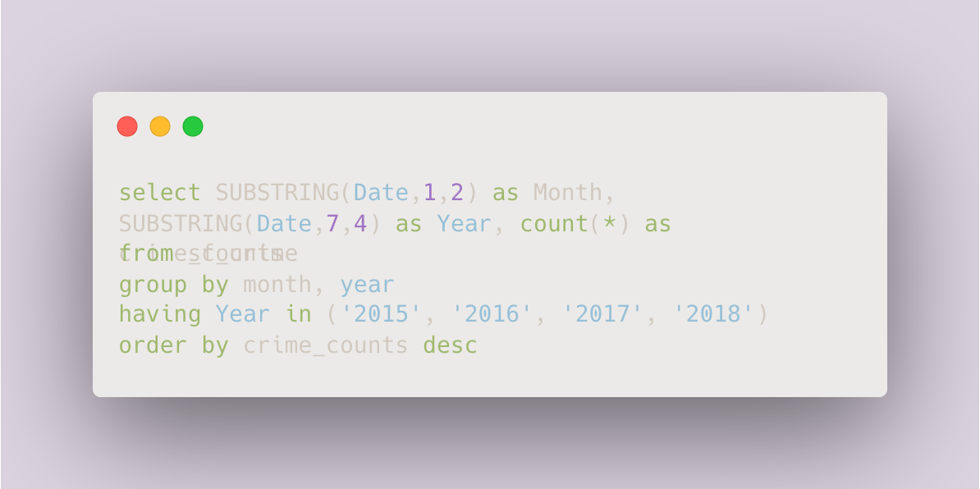
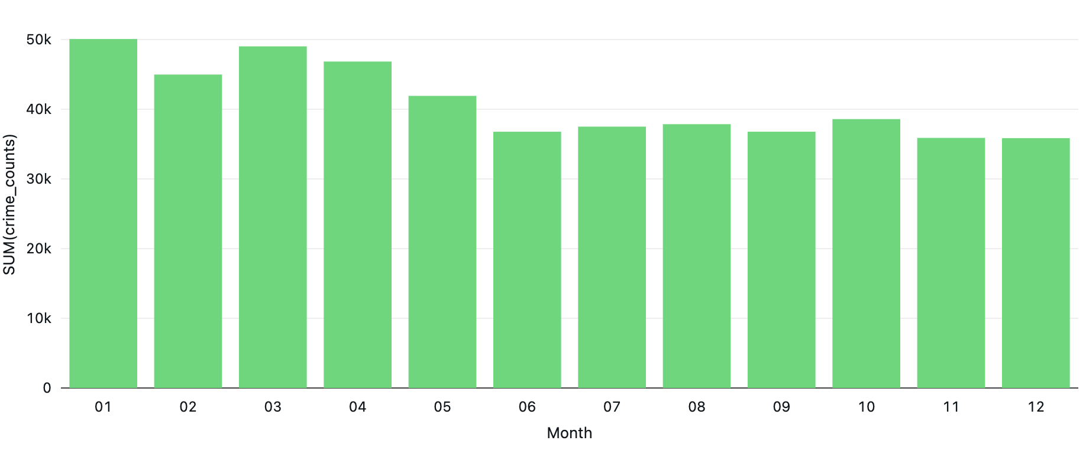
Monthly Crime Trends (2015–2018)
The data shows a consistent rise in crime in January and March across multiple years, possibly linked to post-holiday activity or seasonal social patterns. This trend could support seasonal policing strategies or further correlation with public events.

Slide 8
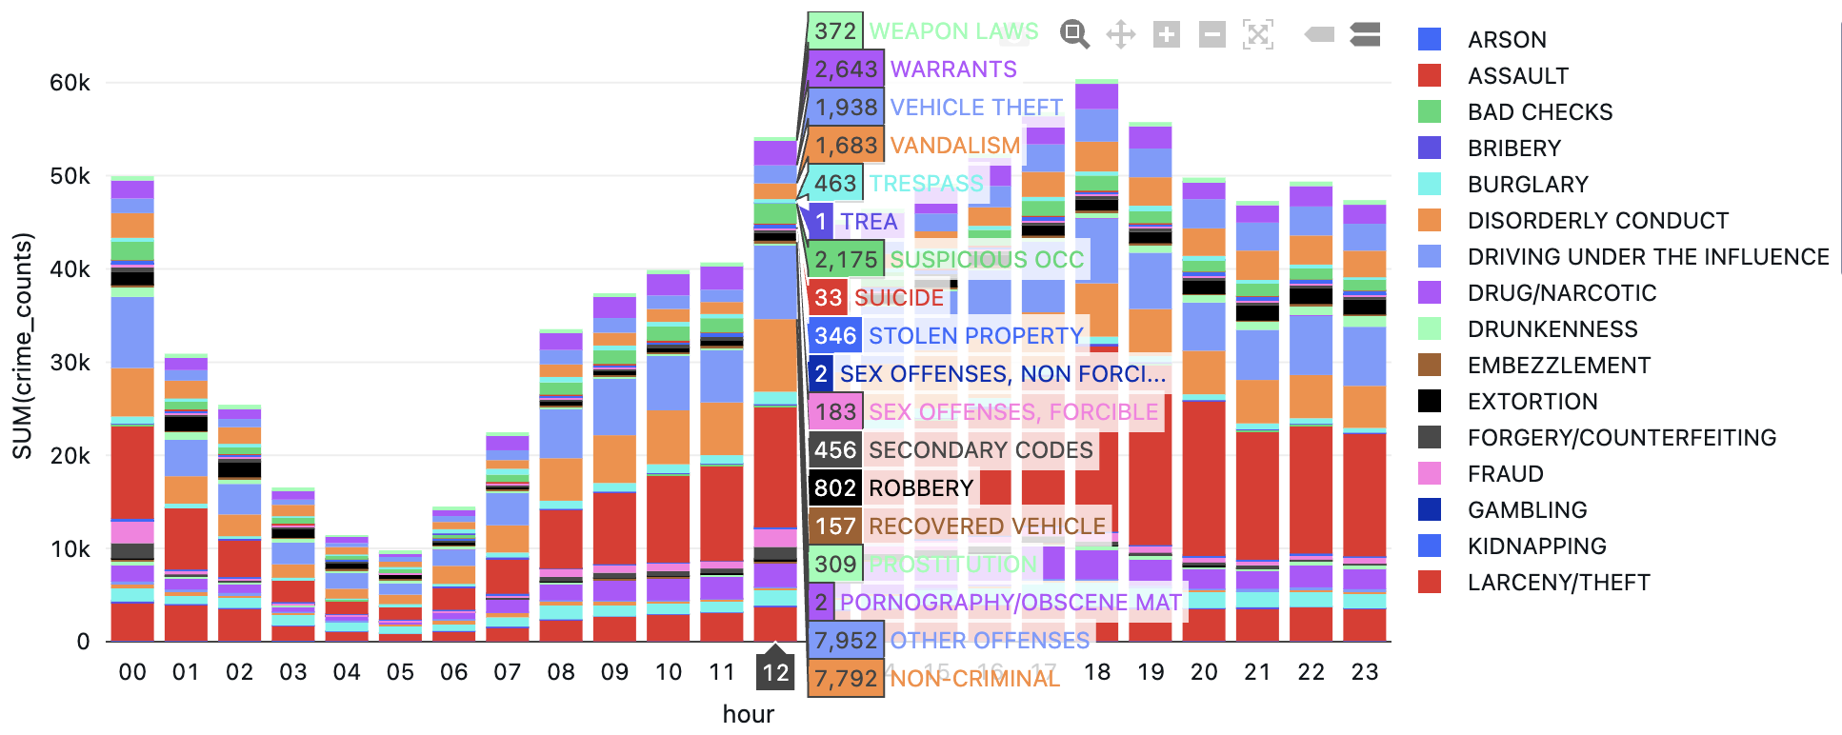
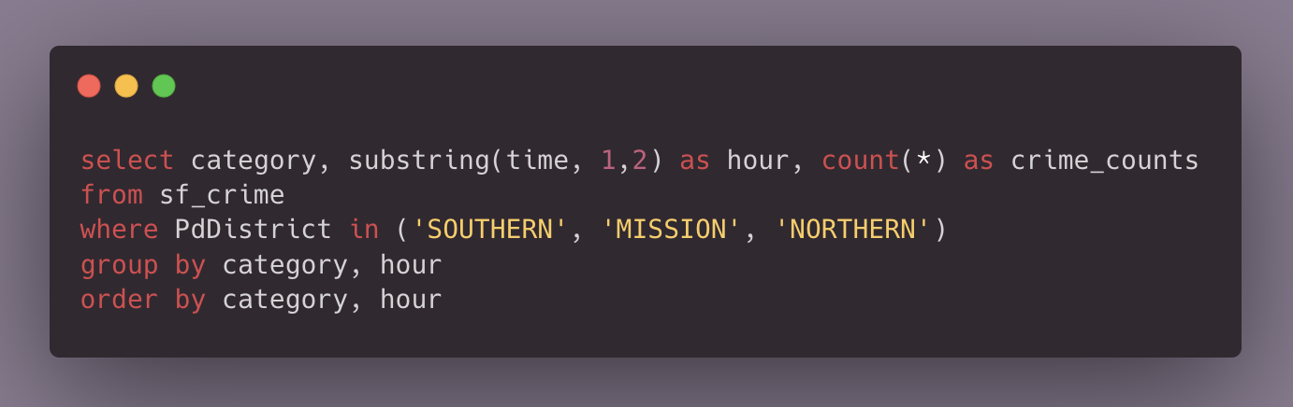
Top Crime Districts & Strategic Police Allocation
The stacked bar chart displays the distribution of crime categories across each hour of the day within the three most dangerous police districts: SOUTHERN, MISSION, and NORTHERN.
Midday to early evening (12 PM to 6 PM) is the highest-risk window for criminal activity in SF’s most dangerous districts.
Theft-related crimes (Larceny, Vehicle Theft) are the most prevalent during peak hours.
Police patrols and resources should be concentrated in these time slots, particularly in districts like Southern and Mission.
Early morning hours present an opportunity for resource reallocation, as crime rates are minimal.

Slide 9
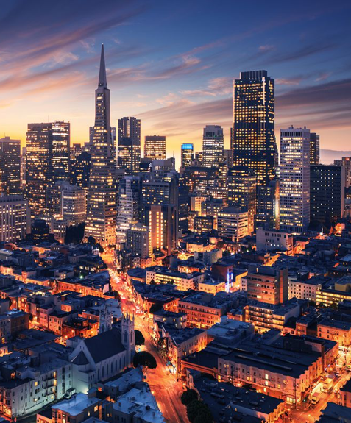
Key Takeaways & Insights
1. Crime Hotspots Identified
The top three most dangerous districts are Southern, Mission, and Northern, each reporting significantly higher incident counts. These findings highlight the importance of localized policing strategies and targeted resource deployment.
2. Peak Crime Times
Crime frequency is lowest between 3 AM and 6 AM and peaks from 12 PM to 6 PM. Theft-related crimes such as Larceny/Theft, Vehicle Theft, and Robbery dominate during peak hours, suggesting a higher need for daytime patrolling.
3. Spatiotemporal Risk Zones
Sunday crimes in downtown SF (as defined by spatial coordinates) show consistent patterns by year and date. This demonstrates how spatial filtering combined with temporal segmentation can inform targeted prevention strategies.
4. Actionable Recommendations
Increase police patrols in the top 3 districts during 12 PM–6 PM, especially focusing on theft-related crimes.
Reduce night shift deployments in low-crime early morning hours (e.g., 4–6 AM) to optimize resources.
Use data-driven insights to implement predictive patrol schedules based on location and hour-specific risk.

Slide 10
Thank you
-Minfei He

